Slide 1



2020 THP Updates
With Emphasis on COVID-19
4/22/2020
Notes:
Thank you for joining me for today’s 2020 THP Updates with an emphasis on COVID-19.
*I’m Roxanne Loughery, Director of Education and Training for The Health Plan.
Also on the call to provide clarification (or correct me) are Christy Donohue, Vice President of Medicaid & Vicki Pennybacker, Vice President of Medicare.
* I want to mention a couple of things before we get started:
*Your telephones are muted to avoid background noise
*I expect this presentation will take the full hour allotted for it & we may not have time at the end to address any questions you may have
*However, you can still communicate with us.
Please note the Control Panel to the right of your screen
*You may minimize or maximize this screen by clicking the orange box with the white arrow at the top of the control panel tool bar.
You may click the plus sign by the word “Questions” in the Control Panel and type your question at any time during the presentation. I will capture those questions and respond to them via email.
This will also be a good way for me to develop frequently asked questions to post to our provider portal.
*With the Control Panel Open, You may Click on the plus sign by the word “Documents” and open and save documents that I have included
*I will email the presentation to the attendees and it will be available in the future on The Health Plan’s Provider secure website.
*You will receive certificate of attendance in a separate email. This training may qualify for CEUs. Please check with your accrediting agency. In this same email you will see the word “Survey” Please clicking on this link to complete a 5 question survey related to the presentation.
Before I get started, I want to get an idea of who is in the audience today.
Poll #1
Please select the description that best describes the office that you are representing today.
Now I really want to get to know my audience.
Poll #2
Ladies and gentleman if you’d like to respond, How long are the roots of your hair?

Slide 2


Disclaimer
This presentation was prepared as a tool to assist providers. Although every reasonable effort has been made to ensure the accuracy of the information within these pages, the ultimate responsibility for the correct submission of claims and response to any remittance advice lies with the provider of services.
Policy changes frequently and links to the source documents have been provided within the document for your reference.
Notes:
Information has been coming fast and furious and at a frantic pace, so here’s my disclaimer. This presentation was prepared with information that is as true as I know it to be as of today’s date. I have made every effort to make sure the information is accurate, but the ultimate responsibility lies with the provider to submit claims correctly. I have provided links to documents in this presentation

Slide 3
Topics
THP & COVID-19
COVID-19 and Copays
COVID-19 and Prior Authorizations
COVID-19 and Telehealth
Medicare Coronavirus Testing Codes
COVID-19 Resources
Prior and Retro Authorizations
eviCore Healthcare
Claims Information
Billing Information
Reimbursement
Access to Care
Surveys
Medicaid ID Card
Training & Education
HEDIS® Coding
Medicaid Attribution Policy
NaviNet
Provider Information
Disclaimer
Contact Information
Notes:
These are the topics we are going to be discussing today. I know COVID-19 is at the forefront of everyone’s minds related to their practice so we are going to jump right in & discuss THP’s response to COVID-19 in the way of copays, authorizations, telehealth and testing codes. Then we are going to discuss general THP updates.

Slide 4


THP &
COVID-19

Slide 5
THP Following CMS & BMS Guidelines
The Health Plan is following the temporary measures related to healthcare services instituted by the Centers for Medicare and Medicaid Services (CMS) and the Bureau for Medical Services (BMS) during the coronavirus (COVID-19) pandemic.
Refer to CMS’ guidelines related to COVID-19 for THP members with Medicare and Fully-Funded (including POS, PPO, HMO, WV PEIA) coverage. Those guidelines may be accessed at https://www.cms.gov/About-CMS/Agency-Information/Emergency/EPRO/Current-Emergencies/Current-Emergencies-page
BMS guidelines related to COVID-19 will be followed by THP for WV Medicaid members. Please visit the “News and Announcements” section of BMS’ website at https://dhhr.wv.gov/bms/Pages/Coronavirus-Disease-2019-(COVID-19)-Alerts-and-Updates.aspx to access the latest information related to COVID-19.
Notes:
When you contact THP you are going to hear the staff tell you that THP is following the temporary measures instituted by CMS and BMS during the COVID pandemic. Again, information is coming out at such a rapid pace that I added 2 slides to this presentation this morning.
Please refer to CMS’s guidelines for THP’s members with Medicare and Fully Funded coverage. Fully funded includes our POS, PPO, HMO & WV PEIA lines of business.
For WV Medicaid members, THP is following BMS’s guidelines.
I’ve provided links to their websites for you.

Slide 6
COVID-19
& Copays

Slide 7
Medicare & Commercial Copays
THP is following CMS guidelines and is waiving copays for Medicare and Commercial members for COVID-19 testing and ALL telehealth services.
Telehealth services are not limited to the treatment and diagnosis of COVID-19.
Notes:
THP is following CMS guidelines and is waiving copays for Medicare and Commercial members for COVID-19 testing and all telehealth services.
Copays have also been waived for Self-Funded participants for COVID-19 testing and all telehealth services.
In other words, telehealth services are not limited to the treatment and diagnosis of COVID-19.

Slide 8
Self-Funded Copays
Copays have been waived for Self-Funded participants for COVID-19 testing.
Contact THP at 1.888.816.3096 regarding telehealth copays for ALL Self-Funded groups.
Notes:
THP is following CMS guidelines and is waiving copays for Medicare and Commercial members for COVID-19 testing and all telehealth services.
Copays have also been waived for Self-Funded participants for COVID-19 testing and all telehealth services.
In other words, telehealth services are not limited to the treatment and diagnosis of COVID-19.

Slide 9
Medicaid Copays Waived
THP is following BMS’ guidelines and is waiving ALL copays for WV Medicaid members during the COVID-19 crisis for dates of service from April 1, 2020 to May 31, 2020.
Telehealth services are not limited to the treatment and diagnosis of COVID-19.
Notes:
Members in the WV Health Bridge Medicaid plan typically have a small copay.
All copays are waived for Medicaid members for DOS April 1 through May 31

Slide 10
COVID-19
& Prior Authorizations

Slide 11
Prior Authorizations (PA) Extended
Due to the COVID-19 pandemic, elective medical procedures have been delayed.
THP will be honoring existing unused prior authorizations (pre-service approvals) granted from 1/1/20 through 3/31/20 to an end date of 12/31/2020 for Medicaid, Medicare, Fully Funded and Self-Funded lines of business.
  Authorizations granted beginning 4/1/20 are automatically extended to 12/31/20.
  This extension is to ensure members receive the clinically appropriate services that may have been postponed or re-scheduled during the pandemic.
  It does NOT provide coverage for additional services (visits, administrations, etc.) beyond what had been approved on the prior authorization (pre-service approval).
Notes:
You know that the COVID-19 pandemic has caused delays for elective medical procedures.
THP will be honoring existing unused prior authorizations (pre-service approvals) that were obtained from 1/1/20 through 3/31/20 and we have extended the authorization end date to 12/31/2020 for all lines of business, including Self-Funded.
You aren’t required to do anything, THP automatically extended those end dates.
Any pre-auths for procedures obtained beginning April 1st were automatically given a 12/31/20 end date
I want to caution you that the authorization extensions will not cover additional services beyond what had been approved on the prior authorization

Slide 12
Medicaid Prior Authorizations
Effective April 1, 2020, BMS waived the requirement to pre-authorize services for MEDICAID members until May 31, 2020.
Includes in network and out-of-network providers
  Providers calling The Health Plan (THP) to authorize services will receive one
EXCEPTION:
  Hospitals, CSUs and SUD residential programs must notify THP of admits and discharges
    Concurrent review is not required
    Observation follows same rules as inpatient
      Observation payment remains the same – up to 48 hours
Notes:
Effective April 1, 2020, BMS waived the requirement to pre-authorize services for MEDICAID members until May 31, 2020.
Providers calling The Health Plan (THP) will be told by customer service that a PA is not required, but they will give you one if you insist on authorizing a service
There is an EXCEPTION to this.
Hospitals, CSUs and SUD residential programs must notify THP of admits and discharges so THP may assist with coordination of care if needed
Concurrent review is not required, but we’ll certainly take it
Observation follows same rules as inpatient
Observation payment remains the same – up to 48 hours

Slide 13
COVID-19
& Telehealth
Notes:
On to the subject that has generated the most confusion for providers and us as well – Telehealth!

Slide 14
Medicare Telehealth
Notes:
Let’s start with Medicare

Slide 15
Common CMS Telehealth Codes
Common Medicare CPT and HCPCs telehealth codes:
99201 – 99215: Office or other outpatient visits
G0425 – G0427: Telehealth consultations, emergency
department or initial inpatient
G0406 – G0408: Follow up inpatient telehealth consultations
furnished to beneficiaries in hospitals or skilled
nursing facility (SNF)
Notes:
These are the most common telehealth services and the corresponding CPT & HCPCs codes available for Medicare recipients.

Slide 16
CMS Expanded Telehealth Codes
CMS has expanded telehealth codes to allow for >80 additional services for Medicare members, beginning March 1, 2020 and continuing through the COVID-19 pandemic to include:
Emergency department visits
  99281-99285
Initial & subsequent observation and observation discharge day management
  99217 – 99220
  99224 – 99226
  99234 – 99236
Initial hospital care and hospital discharge day management
  99221 – 99223
  99238 – 99239
Initial nursing facility visit and nursing facility discharge day management
  99304 – 99306
  99315 - 99316
Notes:
CMS expanded telehealth codes beginning March 1st for the duration of the pandemic to greater than 80 additional services.
Among those, with their allowed CPT codes, are:
Emergency department visits
Initial & subsequent observation and observation discharge day management
Initial hospital care and hospital discharge day management
Initial nursing facility visit and nursing facility discharge day management

Slide 17
CMS Expanded Telehealth Codes Cont.’d
Critical care services
  99291 – 99292
Domiciliary, rest home, custodial care, new and established
  99327 – 99328
  99334 – 99337
Home visits, new and established
  99341 – 99345
  99347 – 99350
Inpatient neonatal and pediatric critical care, initial and subsequent
  99468 – 99469
  99471 – 99473
  99475 - 99476
Initial and continuing intensive care services
  99477 – 99480
Notes:
Critical care services
Domiciliary, rest home, custodial care, new and established
Home visits, new and established
Inpatient neonatal and pediatric critical care, initial and subsequent
Initial and continuing intensive care services

Slide 18
CMS Expanded Telehealth Codes Cont.’d
Care planning for patients with cognitive impairment
  99483
Group psychotherapy
  90853
Psychological and neuropsychological testing
  96130 – 96133
  96136 - 96139
End-stage renal disease
  90952 – 90953
  90959
  90962
Radiation treatment management services
  77427
Notes:
Care planning for patients with cognitive impairment
Group psychotherapy
Psychological and neuropsychological testing
End-stage renal disease
Radiation treatment management services

Slide 19
CMS Telephone E & M Codes
CMS recognizes that some Medicare patients may not have video capability.
Evaluation and management (E & M) services may be conducted via telephone (audio only).
The following CPT codes may be billed and are reimbursable for telephone evaluation and management by physician or other qualified health care professional:
  99441
  99442
  99443
Notes:
CMS recognizes that some Medicare patients may not have video capability.
Evaluation and management (E & M) services may be conducted via telephone (audio only).
These are the CPT codes that may be billed and are reimbursable for telephone evaluation and management by physician or other qualified health care professional:

Slide 20
CMS Response to PT/OT/ST
Physical therapy, occupational therapy and speech therapy may currently only be reimbursed for assessment performed via telephone for Medicare and Commercial members:
CPT codes that may be used:
98966 – 98968 – telephone assessment and management services by a non-physician
health care professional to an established patient, parent or guardian
  Private practice therapists require a modifier of GO, GP or GN
  Facility-based therapists do not require a modifier
Notes:
Currently CMS is permitting reimbursement to PT/OT & ST providers for assessments only and performed via telephone.
THP was on a call with CMS 2 weeks ago & they have heard from the PT/OT/ST community and are discussing telehealth visits, but no direction has been received as of today.
98966 – 98968 are the billable codes.
Private practice therapists bill with the appropriate modifier
Facility-based therapists are not required to bill with a modifier

Slide 21
FQHC/RHC Medicare Telehealth
CMS is permitting FQHC/RHCs to perform visits via telehealth with an interactive audio and video telecommunication system during the COVID emergency.
Telehealth may be furnished by any health care practitioner, within their scope of practice, that is working for the FQHC/RHC.
Practitioners may furnish telehealth from any location, including their home.
Practitioners may furnish any telehealth service approved as a distant site telehealth service under the physician fee schedule. A list is available at: https://www.cms.gov/files/zip/covid-19-telehealth-services-phe.zip
Notes:
Here’s an example of how quickly information is being received.
I just added this slide & the next one this morning.
CMS is permitting FQHC and RHCs to perform visits via telehealth with an interactive audio and video telecommunication system during the COVID emergency.
Telehealth may be furnished by any health care practitioner practicing within the scope of their practice that is employed by an FQHC/RHC.
Practitioners may furnish telehealth from any location, including their home.
Practitioners may furnish any telehealth service approved as a distant site telehealth service under the physician fee schedule. I provided a link to those services on this slide.

Slide 22
FQHC/RHC Billing Telehealth for Medicare
Services provided between January 27 and June 30, 2020 bill with a 95 modifier.
For services furnished from July 1, 2020 until the end of the COVID emergency bill G2025 to identify services furnished via telehealth.
Coinsurances are waived for services related to COVID-19 testing, including telehealth.
Use CS modifier on claim line for services to indicate waived coinsurance
Refer to MLN Matters Number: SE20016, article release date: April 17, 2020 for additional information.
Notes:
Per CMS, services provided between January 27 and June 30, 2020 should be billed with a 95 modifier.
For services furnished from July 1, 2020 until the end of the COVID emergency bill G2025 to identify services furnished via telehealth.
Coinsurances are waived for services performed that are related to COVID-19 testing, including telehealth.
Use CS modifier on claim line for services to indicate waived coinsurance
The MLN Matters Number is shown for additional information

Slide 23
Billing Medicare Telehealth Services
THP is following CMS guidelines for telehealth services rendered during the COVID-19 pandemic. Telehealth services are not limited to the treatment and diagnosis of COVID-19.
For Medicare and Commercial lines of business:
Bill the place of service (POS) code where services would typically be performed on a HCFA1500 claim form
  THP will not deny telehealth claims billed with POS 02
Bill applicable procedure code(s) with modifier 95.
Add modifier 95 to CPT/HCPCs code on Hospital claims for services furnished via telehealth.
Notes:
The most common question that THP is receiving is how do I bill for telehealth?
And no wonder you are confused. CMS first instructed providers to bill with a place of service 02, then came out & said bill the POS you typically would bill on a 1500 claim form with a 95 modifier.
Rest assured, THP will pay claims billed with the 02 or the typical place of service code.
Please do not bill a POS 02 with a 95 modifier on the same claim.

Slide 24
Medicaid Telehealth

Slide 25
Medicaid Telehealth
THP is following BMS guidelines for telehealth services rendered during the COVID-19 pandemic. Telehealth services are not limited to the treatment and diagnosis of COVID-19.
On March 17, 2020, BMS issued a memorandum allowing for services to be rendered through telehealth (audio and visual) or telephonic (audio only) modalities to ensure continuation and access to services for Medicaid members.
Providers should:
Use their best judgement on what services can be performed in this setting
Must work within the scope of their license
Have access to the patient’s previous records (for established patients)
Obtain consent from the patient, verbal or written, to provide services via telehealth and document in the member’s record
Notes:
THP is following BMS guidelines for telehealth services rendered during the COVID-19 pandemic. Telehealth services are not limited to the treatment and diagnosis of COVID-19.
BMS issued a memo on March 17th allowing services to be provided by telehealth and telephone to allow Medicaid members access to providers.
We want to remind providers to use your best judgement on what services can be performed in this setting
Providers must work within the scope of their license
You must have access to established patient’s previous records
And you must obtain consent from the patient, either verbal or written, to provide services via telehealth and document consent in the member’s record

Slide 26
Behavioral Health Telehealth
In relation to substance use disorder services, SAMSHA has issued guidance on 42 CFR part 2 that allows for greater flexibility. The link for more information can be found at: https://www.samhsa.gov/sites/default/files/covid-19-42-cfr-part-2-guidance-03192020.pdf
Notes:
SAMSHA is allowing greater flexibility for substance use disorder services provided via telehealth.
A link to the website containing more information is provided on this slide.

Slide 27
FQHC Billing Telehealth E & M for Medicaid
BMS is allowing FQHCs to perform non-emergent evaluation and management (E & M) visits via telehealth to a Medicaid member in their home.
Bill encounter code T1015 with the supporting procedure code
  Add GT modifier to procedure code(s)
Do not bill Q3014 – telehealth originating site facility fee
  No reimbursement for Q3014
Notes:
BMS is now allowing FQHCs to perform non-emergent evaluation and management (E & M) visits via telehealth to a Medicaid member in their home.
Bill the encounter code T1015 with the supporting procedure code and add the GT modifier to the procedure code or coes
Do not bill Q3014 – telehealth originating site facility fee
There is no reimbursement for Q3014

Slide 28
PT/OT/ST for Medicaid Members
BMS permits PT/OT/ST services rendered via live video conferencing or telephonic to a members’ home with a Medicaid enrolled provider.
See BMS memo posted at: https://dhhr.wv.gov/bms/Documents/OT%20PT%20Speech%20COVID%20Precautions.pdf
20 Combined visit limit applies to PT and OT
Notes:
BMS is permitting PT/OT/ST services rendered via live video conferencing or telephone to a members’ home if you are a WV Medicaid enrolled provider.
BMS’s memo is posted at the link provided
Reminder that Medicaid has a 20 visit combined PT and OT benefit

Slide 29
Billing Medicaid Telehealth Services
For Medicaid members only:
HCFA 1500 professional claim form:
  Bill the appropriate CPT/HCPCs code
  Use 02 for the place of service
    Do not bill modifier 95 – claims will deny
UB04 facility claim form:
  Bill the appropriate CPT/HCPCs code
  Use the -GT modifier
Notes:
To bill services provided to WV Medicaid members:
On a 1500 form bill 02 as the POS and bill the appropriate CPT/HCPCs code.
We have received numerous phone calls about the use of modifier 95 on Medicaid claims & BMS has stated that is not acceptable.
Medicaid claims will deny if billed with modifier 95
If you are a facility billing on a UB04 claim form, please bill the appropriate CPT/HCPCs code and use the GT modifier to indicate services were performed via telehealth.

Slide 30
Medicare Coronavirus Testing Codes

Slide 31
Coronavirus Testing Codes
CDC recommends collecting a single upper respiratory nasopharyngeal swab.
Beginning 4/1/2020 the following coronavirus testing codes may be submitted for dates of service on or after 2/4/2020.
For Medicare and Fully Funded lines of business bill:
CDC diagnostic lab test
  U0001
Non-CDC diagnostic lab test (depending on method used)
  U0002
Notes:
On April 1st CMS announced that U0001 & U0002 may be submitted for coronavirus tests conducted on or after 2/4/20.

Slide 32
Coronavirus Testing Codes
Effective on or after DOS 3/13/2020, Medicare and Fully Funded lines of business may bill:
Non-CDC diagnostic lab test (depending on method used)
  CPT 87635
No copayments are applied
Drive thru coronavirus testing bill place of service code O2
Testing permitted by a home health nurse for Medicare patients in home health during a covered visit.
Notes:
CMS then added CPT code 87635 for dates of service on or after 3/13/20.
No copayments are applied to coronavirus testing codes
Bill drive thru testing with POS 02
CMS does permit testing by a home health nurse for Medicare patients in home health

Slide 33
Medicaid Coronavirus Testing Codes

Slide 34
Medicaid Coronavirus Testing Codes
The following coronavirus testing codes may be submitted for Medicaid members for dates of service on or after 2/4/2020:
  U0001
  U0002
The following codes were approved for DOS on or after 3/1/2020:
  G2023
  G2024, SNF or lab on behalf of a home health agency
The following code was approved for DOS on or after 3/13/2020:
  CPT 87635
Effective with DOS on or after 3/18/2020 the following testing codes were approved:
  U0003
  U0004
No copayments are applied
Drive through coronavirus testing bill place of service code O2
Notes:
Medicaid has approved various coronavirus testing codes with various approval dates
THP just received notice from BMS on Monday that U0003 & U0004 were added
Like Medicare, no copayments are applied to Medicaid testing claims and bill POS 02 for drive thru testing.

Slide 35
Medicaid NEMT &COVID-19

Slide 36
Non-Emergency Medical Transportation
THP will arrange ambulance transportation for suspected or confirmed COVID-19 Medicaid members.
Providers may assist members by contacting THP on their behalf.
Medical necessity will be deemed met due to the isolation requirement for COVID-19 patients.
Notes:
THP also received guidelines from BMS this week on Non-emergency medical transportation.
Ambulance transport for suspected or confirmed COVID-19 Medicaid members will be arranged by the managed care organizations.
You, the provider may assist members by contacting THP on their behalf.
Medical necessity is considered met due to the isolation requirement for COVID-19 patients.

Slide 37
COVID-19 Resources

Slide 38
Resources to Give You Up-to-Date
Information on COVID-19
The Health Plan’s Provider Portal myplan.healthplan.org “Resource Library” “COVID-19”
The Health Plan’s Corporate Website https://healthplan.org/important-covid-19-information
Centers for Medicare and Medicaid Services Current Emergencies: https://www.cms.gov/About-CMS/Agency-Information/Emergency/EPRO/Current-Emergencies/Current-Emergencies-page
Bureau for Medical Services COVID-19 Alerts and Updates: https://dhhr.wv.gov/bms/Pages/Coronavirus-Disease-2019-(COVID-19)-Alerts-and-Updates.aspx
Notes:
Both THP’s public website and secure provider portal contain information on COVID-19.
Again I listed CMS & BMS’s websites for your reference.

Slide 39
Prior & Retro Authorizations
Notes:
I’m going to go over general updates, starting with prior & retro authorizations

Slide 40
PT/OT Chiropractic Prior Auth
Effective December 1, 2019, no pre-authorization is required for the first 20 visits for chiropractic services and the first 20 combined physical therapy (PT) and occupational therapy (OT) visits per event and/or year.
Visit limitations for THP Medicaid and Medicare lines of business follow a calendar year.
Commercial plan (including HMO, POS, PPO and WV PEIA) visit limitations are based on a contract year.
Submit pre-authorization requests to Palladian Health beginning with the 21st chiropractic and 21st combined PT/OT visits.
BMS has waived the requirement to pre-authorize services for MEDICAID members through
May 31, 2020.
Notes:
Just a reminder that on December 1, 2019, THP announced to PT, OT and chiropractic providers that no pre-authorization is required for the first 20 visits for chiropractic services and the first 20 combined physical therapy (PT) and occupational therapy (OT) visits per event and/or year.
Visit limitations for THP Medicaid and Medicare lines of business follow a calendar year.
Commercial plan (including HMO, POS, PPO and WV PEIA) visit limitations are based on a contract year.
Beginning with the 21st chiropractic and 21st combined PT/OT visits, providers must submit pre-authorization requests to Palladian Health

Slide 41
SUD Prior Auth Form
A universal Substance Use Disorder (SUD) Waiver Form has been developed and accepted by all the managed care organizations to request SUD services for Medicaid members.
Requests for additional clinical information by THP may be unnecessary if the provider completes the form in its entirety.
This form is available in fillable format on THP’s provider portal: myplan.healthplan.org “Forms” “Behavioral Health Forms”
Use of the form is not mandated. THP will continue to accept the THP specific version of the SUD service request form.
Direct questions to the Clinical Services Department at
1.800.624.6961, ext. 7643 or 7644.
BMS has waived the requirement to pre-authorize services for MEDICAID members through
May 31, 2020, however, notification is still required.
Notes:
With input from the 3 Medicaid managed care companies in WV, BMS created a universal Substance Use Disorder (SUD) Waiver Form to be used to request SUD services for Medicaid members.
This form is available in fillable format on THP’s provider portal: myplan.healthplan.org “Forms” “Behavioral Health Forms”
Providers don’t have to use this form, you may continue to use THP’s version of the SUD service request form.
Again, BMS waived the requirement to pre-auth services for Medicaid members through May 31st, but we encourage SUD providers to use this form.
You are required to notify THP of Medicaid members receiving SUD services during the pandemic.

Slide 42
Retrospective Authorization Guidelines
Only services on THP’s pre-authorization list deemed urgent/emergent, rendered without prior auth, are eligible for retro auth.
  Includes inpatient and outpatient services
Request authorization based on THP’s medical and behavioral health pre-auth lists before a service is rendered.
  The pre-auth lists are available at: http://myplan.healthplan.org/
Request authorization next business day for services conducted on weekends, after hours or holiday.
Failure to follow prior auth guidelines will result in denied claims.
BMS has waived the requirement to pre-authorize services for MEDICAID members through
May 31, 2020.
Notes:
Only services on THP’s pre-authorization list deemed urgent/emergent, rendered without prior auth, are eligible for retro auth.
Includes inpatient and outpatient services
Request authorization based on THP’s medical and behavioral health pre-auth lists before a service is rendered. The lists are contained on THP’s provider portal.
Request authorization next business day for services conducted on weekends, after hours or holiday.
Failure to follow prior auth guidelines will result in denied claims.
Again, BMS has waived the pre-auth requirement through May 31, 2020.

Slide 43
eviCore healthcare

Slide 44
eviCore Implementation
The Health Plan (THP) partnered with eviCore healthcare to manage medical necessity and prior authorization for the following services for all Medicaid, Medicare and fully insured lines of business effective December 16, 2019:
Durable Medical Equipment (DME)
Sleep Studies
Radiology/Cardiology, including:
  Advanced imaging (including cardiac advanced imaging)
  CT, MRI, PET
  Nuclear Medicine (non-cardiac)
BMS has waived the requirement to pre-authorize services for MEDICAID members through
May 31, 2020.
eviCore has notified providers about modifications to the prior authorization process for DME and Sleep Studies during the COVID-19 emergency. Please access information at eviCore.com or 877.791.4101.
Notes:
The Health Plan (THP) partnered with eviCore healthcare to manage medical necessity and prior authorization for DME, Sleep studies, radiology and cardiology for all Medicaid, Medicare and fully insured lines of business effective December 16, 2019.
DME and sleep study providers should have received notice from eviCore regarding modifications to the pre-auth process during the COVID emergency. The notice may be accessed on eviCore’s website shown here.

Slide 45
eviCore Implementation PAC
Effective January 1, 2020 eviCore healthcare began managing medical necessity and prior authorization for Post-Acute Care for the Medicare line of business
Post-Acute Care includes:
  Skilled nursing
  Home health
  Long term acute care
  Inpatient rehab
eviCore has notified providers about modifications to the prior authorization process for the above services during the COVID-19 emergency. Please access information at eviCore.com or 877.791.4101.
Notes:
Then on January 1, 2020 eviCore healthcare began managing medical necessity and prior authorization for Post-Acute Care for the Medicare line of business
Again, PAC providers should have received notice from eviCore regarding modifications to the pre-auth process during the COVID emergency. The notice may be accessed on eviCore’s website shown here.

Slide 46
Claims

Slide 47
Timely Claims Filing
Effective January 1, 2020, the timely claims filing deadline for all claims is 180 days from date of service (DOS).
Applies to Commercial, Medicaid and Medicare lines of business.
Claims with DOS up to, and including, December 31, 2019 follow THP’s previous timely claims filing deadline of 365 days from DOS.
When THP is the secondary payer, THP claims must be submitted within 180 days from the DOS, but no later than 90 days from the date of the primary carrier’s Explanation of Benefits (EOB).
If a claim requires a correction, you have the greater of 180 days from the claim payment/denial date or 180 days from the DOS to do so.
Notes:
THP notified providers last fall that the timely claims filing deadline would change to 180 days from DOS beginning 1/1/20.
This applies to Commercial, Medicaid and Medicare lines of business.
Claims with DOS up to, and including, December 31, 2019 follow THP’s previous timely claims filing deadline of 365 days from DOS.
When THP is the secondary payer, THP claims must be submitted within 180 days from the DOS, but no later than 90 days from the date of the primary carrier’s Explanation of Benefits (EOB).
If a claim requires a correction, you have the greater of 180 days from the claim payment/denial date or 180 days from the DOS to do so.

Slide 48
Non-Par Denied Claims
Submitted claims must accurately reflect the rendering provider.
For Medicaid members, if a claim is denied due to the rendering provider not being enrolled with BMS, it is inappropriate to resubmit the claim indicating a different provider rendered the service.
These resubmitted claims will be denied, and a referral will be made to our Special Investigation Unit (SIU).
Notes:
It is inappropriate to re-bill a Medicaid claim under a different provider if a claim denied due to the rendering provider not being enrolled with BMS.
A referral will be made to THP’s SIU.

Slide 49
Resubmitting Paper Claims - Professional
To avoid a duplicate denial THP requires a new CMS 1500 claim form when resubmitting a professional claim on paper. Box 22 on the 1500 form must contain one of the following codes:
  7 – Replacement of prior claim
  8 – Void/cancel prior claim
Attach a copy of the payment voucher with the member circled or underlined.
Include a clear explanation and/or additional documentation as to why the claim is being re-submitted.
Indicate on the claim form “corrected” or “resubmitted claim”
Notes:
When resubmitting professional claims on paper. Please complete & submit a new 1500 claim form with Box 22 completed with a .
7 – Replacement of prior claim or an
8 – Void/cancel prior claim
Attach a copy of the payment voucher with the member circled or underlined.
Include a clear explanation and/or additional documentation as to why the claim is being re-submitted.
Indicate on the claim form “corrected” or “resubmitted claim”.

Slide 50
Resubmitting Paper Claims - Hospital
THP requires a new UB04 claim form when resubmitting a hospital claim on paper.
  Use Bill Type 117 to represent a hospital inpatient replacement or corrected claim to a previously submitted hospital inpatient claim that has paid in order for THP to reprocess the claim.
Attach a copy of the payment voucher with the member circled or underlined.
Include a clear explanation and/or additional documentation as to why the claim is being re-submitted.
Indicate on the claim form “corrected” or “resubmitted claim”
Notes:
If you are resubmitting a hospital claim on paper, please complete a new UB04 hospital claim.
Use Bill type 117 to indicate a replacement or corrected inpatient hospital claim.
Again,
Attach a copy of the payment voucher with the member circled or underlined.
Include a clear explanation and/or additional documentation as to why the claim is being re-submitted.
Indicate on the claim form “corrected” or “resubmitted claim”

Slide 51
Billing Information

Slide 52
Billing Outpatient Services Performed in Hospitals
Effective January 1, 2020, CPT/HCPCs codes are required to be submitted with the applicable revenue code for all outpatient services provided to Medicaid members in an acute or critical access hospital setting.
Claims billed with revenue codes submitted without the corresponding procedure code(s) will be denied.
Notes:
THP is requiring CPT/HCPCs codes be submitted with the applicable revenue code for all outpatient services provided to Medicaid members in an acute or critical access hospital setting.
Claims billed without the corresponding procedure code(s) will be denied.

Slide 53
Emergency Room Reimbursement
THP is following BMS guidelines pertaining to reimbursement for emergency room services rendered to Medicaid members in an acute care hospital.
The enhanced reimbursement is all-inclusive and includes:
Use of emergency room
Routine supplies (such as sterile dressings)
Pharmacy charges
Minor supplies (bandages, slings, finger braces, etc.)
Suture, catheter, and other trays
IV fluids and supplies
Routine EKG monitoring
Oxygen administration and O₂ saturation monitoring
Diagnostic procedures including lab and radiology may be billed separately and in addition to the emergency room services.
Notes:
THP is following BMS’s guidelines pertaining to emergency room services rendered to Medicaid members in an acute care hospital.
The enhanced reimbursement is all-inclusive and includes the list of services and supplies on this slide.
Diagnostic procedures including lab and radiology may be billed separately.

Slide 54
Access to Care

Slide 55
Access to Care - PCP
THP’s access to care standards will change on 7/1/2020 to align with BMS’ requirements:
Provider accessibility standards for PCPs include:
PCPs available 24/7 with appropriate call coverage and after-hours answering service for urgent/emergent conditions.
Routine (other than preventive) care (exemptions permitted when PCP capacity is temporarily limited) | Within14 calendar days
Adult urgent care | Within 48 hours
Pediatric urgent care | Seen same day
Notes:
THP’s access to care standards will change on 7/1/2020 to align with BMS’ requirements.
PCP accessibility standards include:
Routine care within 14 calendar days
Adult urgent care with 48 hours
Pediatric urgent care seen the same day

Slide 56
Access to Care - PCP
Provider accessibility standards for PCPs
Emergent cases | Seen immediately or refer to an emergency facility
Physical exams | Within 180 calendar days
Preventive/EPSDT | Within 30 days
In office wait time | Within one hour of appointment time
Notes:
Emergent cases Seen immediately or refer to an emergency facility
Physical exams Within 180 calendar days
Preventive/EPSDT Within 30 days
Patients seen within one hour of appointment time

Slide 57
Access to Care - Specialist
Provider accessibility standards for Specialists
New or established patients | Within 30 calendar days
In office wait time | Within one hour of appointment time
Notes:
Specialist access to care standards include
New or established patients seen Within 30 calendar days
Patients seen within 1 hour of appointment time

Slide 58
Access to Care - Prenatal
Provider accessibility standards for Prenatal Care
Initial prenatal visit | Within 14 calendar days of when a woman is found to be pregnant
First and second trimester visits | Within 7 calendar days
Third trimester visit | Within 3 calendar days
High risk pregnancy | Within 3 calendar days of identification of high risk
Notes:
Prenatal access to care standards:
Initial prenatal visit Within 14 calendar days of when a woman is found to be pregnant
First and second trimester visits Within 7 calendar days
Third trimester visit Within 3 calendar days
High risk pregnancy Within 3 calendar days of being identifihigh risk

Slide 59
Surveys

Slide 60
Clinical Survey
epiSource distributed clinical surveys to providers.
Thank you to the providers who have responded.
THP’s Provider Engagement representatives will be/have been following up with providers that indicated dissatisfaction in any area(s) and those that requested additional education.

Slide 61
Practitioner Satisfaction Survey
Practitioner satisfaction surveys will be distributed soon via Survey Monkey.
Please take the time to complete the survey.
Information obtained is used to:
Create action plans to improve interactions and remove potential barriers to care.
Improve communication and increase understanding between THP and providers.
Plan webinars, newsletter articles, email blasts and other correspondence.

Slide 62
Medicaid
ID Card

Slide 63
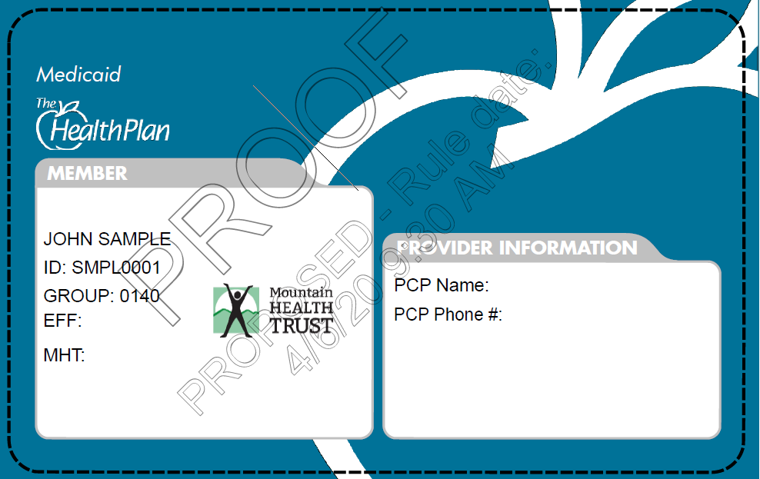
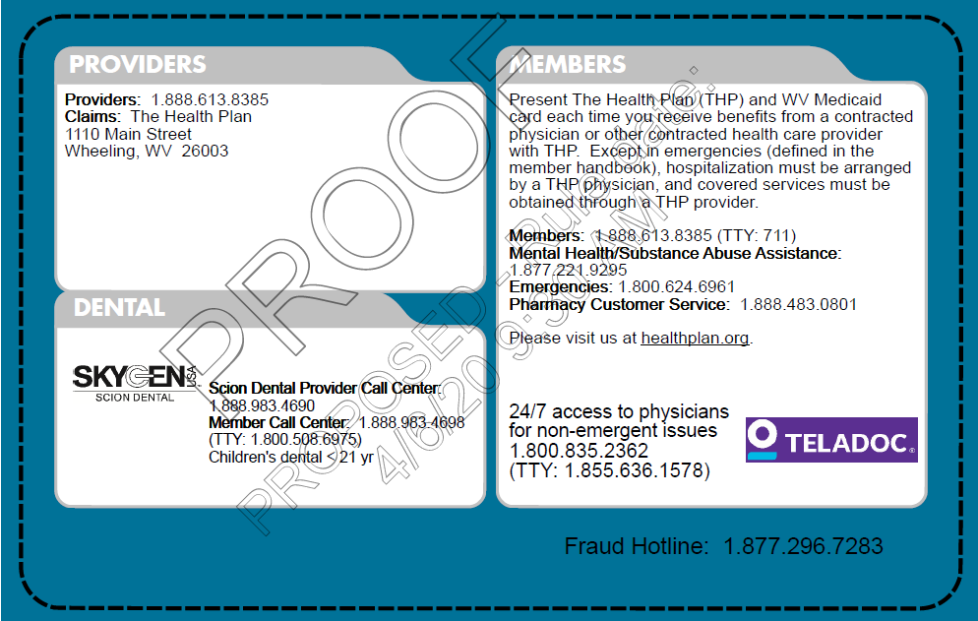
New Medicaid ID Card
Teladoc services are now available to Medicaid members

Slide 64
Training & Education

Slide 65
DSNP Annual Training
DSNP is a THP Medicare advantage plan
Members have SecureCare HMO primary
WV or OH state Medicaid secondary
Member responsibility is dependent upon their level of Medicaid assistance.
The Centers for Medicare and Medicaid Services (CMS) require annual training of providers providing services to members of THP’s dual-eligible special needs population (D-SNP).

Slide 66
DSNP Annual Training
Provider engagement reps will contact providers providing services to five or more D-SNP members in a calendar year to complete and attest to the training.
  THP encourages providers to return the attestation forms as soon as possible after receipt of the training materials.
Training materials and the attestation form are available on The Health Plan’s secure provider website under “Resource Library,” “Training and Education”

Slide 67
Cultural Competency/Social Determinants of Health
CMS requires ALL providers complete cultural competency training.
BMS requires Medicaid enrollees to receive services in a culturally competent manner.
THP has updated their cultural competency training slides to include social determinants of health.
THP tracks network providers to ensure compliance and it is noted in THP’s provider directories.
Login to THP’s provider website at myplan.healthplan.org to access training materials and complete the attestation form under “Resource Library” “Training and Education.”
Attestation from another MCO or proof of attendance at a seminar is acceptable.

Slide 68
What are Social Determinants of Health?
Social Determinants of Health (SDoH) are conditions that shape a patient’s health risks and outcomes, including where people:
Are born
Live
Work
Play

Slide 69
Help The Health Plan Help Your Patients
Incorporate questions related to SDoH into your patient assessments
Code SDoH barriers on the claim
Use diagnosis code Z55 - Z65 to denote “persons with potential health hazards related to socioeconomics and psychosocial circumstances”
These codes are permitted to be reported on claims based on documentation from any clinician involved in care

Slide 70
Help The Health Plan Help Your Patients
Coding SDoH assists THP in identifying barriers that stand in the way of members accessing care and allows THP to track the delivery of services to address SDoH
After identification of an SDoH, a THP social worker can assist members in accessing socially necessary services
Call THP and ask for a care navigator or social worker to assist
with referrals

Slide 71
HEDIS® Coding

Slide 72
HEDIS® 2020 Coding Guidelines
The Health Plan (THP) has developed a coding guide to assist you in billing to capture
HEDIS measures for 2020.
The measures are divided into the following categories:
Prevention and screening
Respiratory conditions
Cardiovascular
Diabetes
Musculoskeletal
Behavioral health
Medication management
Access/availability of care
Use of services
Adjusted utilization and other measures
Log in to the secure provider site to view the measures and CPT codes under “Resource Library,” “Quality Measures”

Slide 73
Medicaid Attribution
Policy

Slide 74
Medicaid Attribution Policy
Who: Medicaid members, including TANF, Expansion and SSI
but NOT D-SNP
What: Attributing members to the PCP the member sees the most often
When: Once annually
  Due to the COVID-19 emergency we project providers will receive this year’s attribution list in July 2020
Where: Your member roster, which is available for download from The Health Plan’s provider portal at myplan.healthplan.org/Account/Login

Slide 75
Medicaid Attribution Policy Cont.’d
Why: Ensure a stronger PCP relationship and accurate distribution of gap reports and member-affiliated communications; reduce confusion about PCP panels
How: Medicaid members will be attributed to the PCP who he or she sees the most often according to an 18-month lookback of claims history; exceptions to attributing a member are:
  If a member has selected his or her PCP with The Health Plan;
  If the new PCP does not have an open panel;
  If a member does not see a PCP during the claims lookback period or
  If a member sees his or her currently assigned PCP the same number of times as another PCP

Slide 76
NaviNet

Slide 77
NaviNet
THP has contracted with NaviNet to offer providers free web access to the following services effective May 2020:
Member eligibility and benefit information
Claims status information
Pre-authorization submission & status (October 2020)
Electronic claims submission, including coordination of benefits claims (coming in 2021)
Uploading documentation (later in 2020)

Slide 78
Provider Information

Slide 79
Provider Notifications
THP’s primary source of provider notification is via email.
THP can store 10 emails per provider in the system.
Cannot accept role-based emails
(i.e., credentialing@__.com; enrollment@__.org; billing@__.com, etc.)
Unsubscribing from an email blast will unsubscribe a provider from all electronic communication, including the ProviderFocus quarterly newsletter.
Contact your provider engagement rep to add your email address under your provider/group tax identification number.

Slide 80
CMS Requests Data Review & Attestation
CMS is requesting that providers review their demographic information in the National Plan and Provider Enumeration System (NPPES) registry, make necessary corrections and attest to the accuracy of the data.
The purpose is to reduce the need for payers, such as The Health Plan, to contact providers to verify demographic directory data.
Access the NPPES NPI registry at: https://nppes.cms.hhs.gov/ - / and use your NPPES log-on credentials to access your information.

Slide 81
Verify and Update Information on THP’s Website
To ensure you are correctly listed in THP’s directories:
Click Find Providers on healthplan.org website
Click “Search Online” button under appropriate member line of business
Enter last name
Select “All” providers and click “submit”
Double click on appropriate underlined provider name
“Verify/Update Practice Info”
Option to “Confirm No Changes” or update erroneous information
You will need the provider’s tax ID and NPI number(s)
Submitted directly to provider support department to update THP system

Slide 82
Disclaimer

Slide 83
Disclaimer
Every reasonable effort has been made to assure the accuracy of the information within these pages. Information continues to be updated frequently.
Please rely on CMS and BMS guidelines during this crisis for up-to-date information.
CMS’ guidelines related to COVID-19 may be accessed at https://www.cms.gov/About-CMS/Agency-Information/Emergency/EPRO/Current-Emergencies/Current-Emergencies-page
BMS’ guidelines related to COVID-19 are located under the “News and Announcements” section of BMS’ website at https://dhhr.wv.gov/bms/Pages/Coronavirus-Disease-2019-(COVID-19)-Alerts-and-Updates.aspx

Slide 84
Contact Information

Slide 85
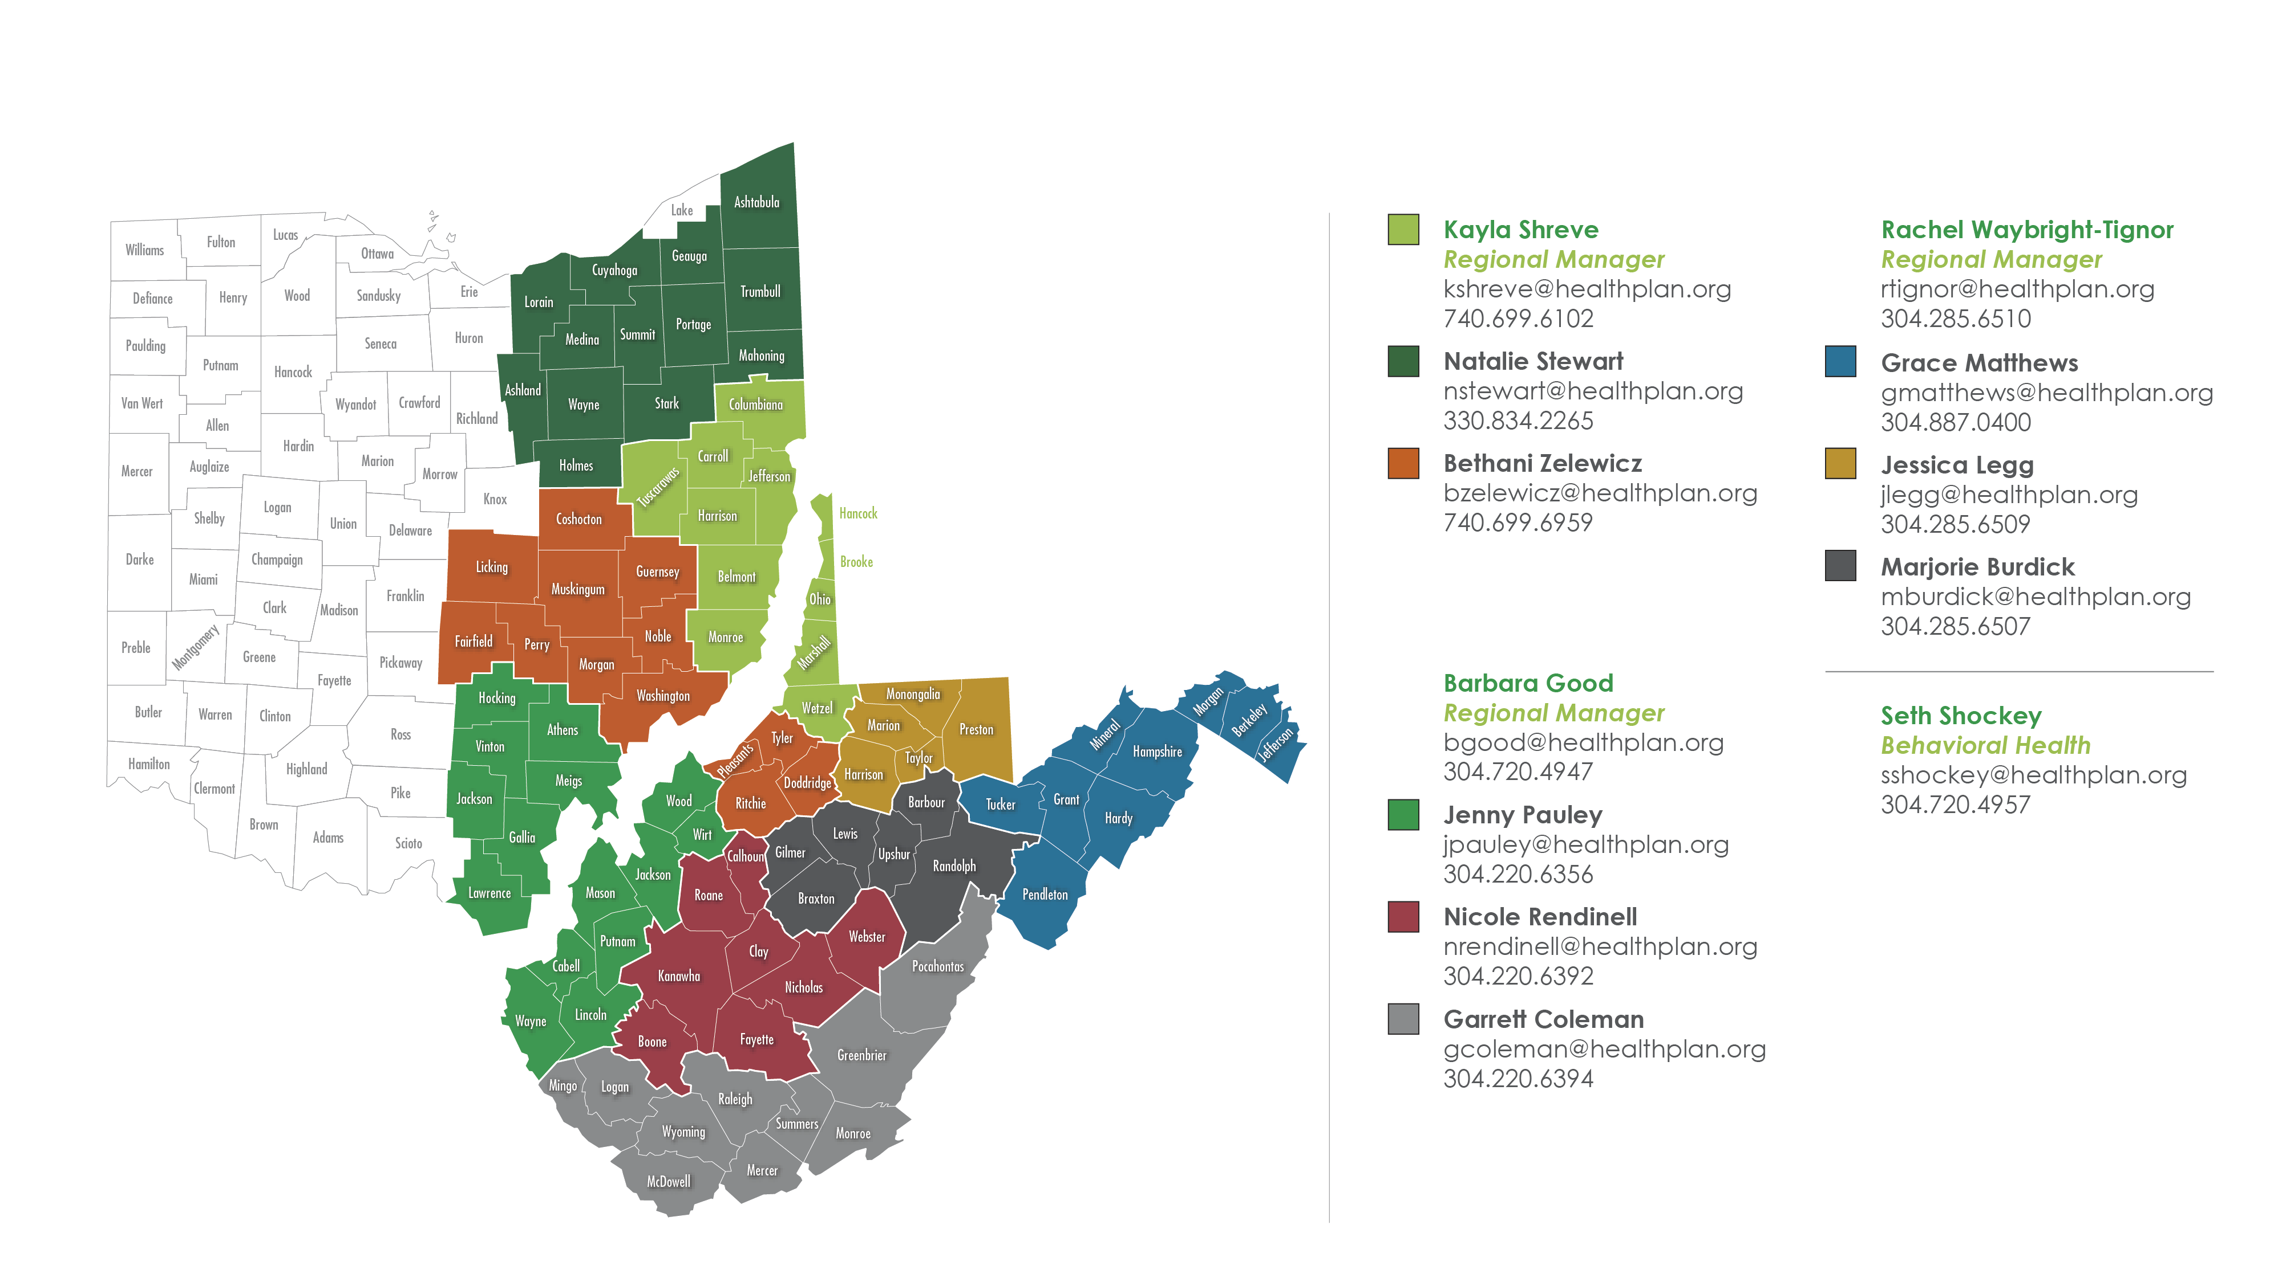
Regional Representative Map

Slide 86

Contact
Medicaid Customer Service
1.888.613.8385
Medicare Customer Service
1.877.847.7907
Fully Funded Customer Service
1.888.847.7902
Self-Funded Customer Service
1.888.816.3096
1110 Main Street
Wheeling, WV 26003-2704

